Slide 1
Presentation on Fundamentals and Essentials
TEAM 05
Arpan Chakrabarty
Oindrila Dey
Moh Suhail
Nikitha N
Bhavani Barnela
Saurav Srivastava

Slide 2
Contents
Hardware Fundamentals
Windows Fundamentals
Linux Fundamentals
Network Fundamentals
Network Services
Database
Applications
Storage

Slide 3
HARDWARE
FUNDAMENTALS

Slide 4
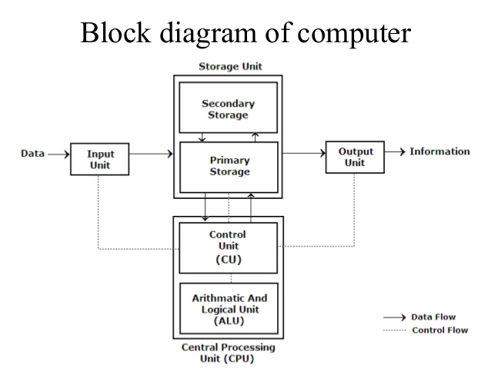
Block Diagram of Computer

Slide 5

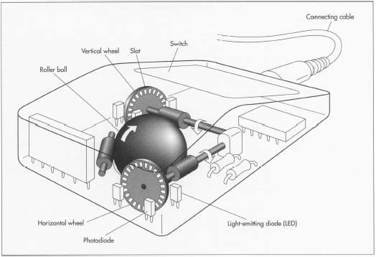
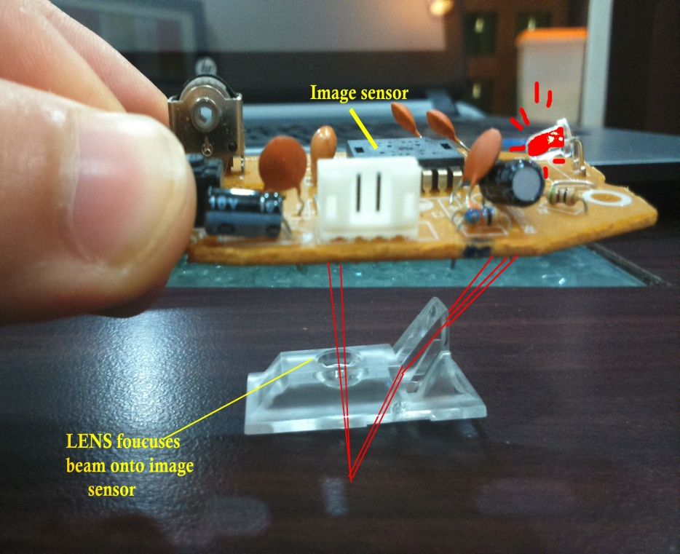
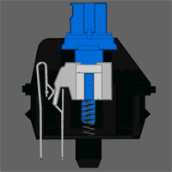
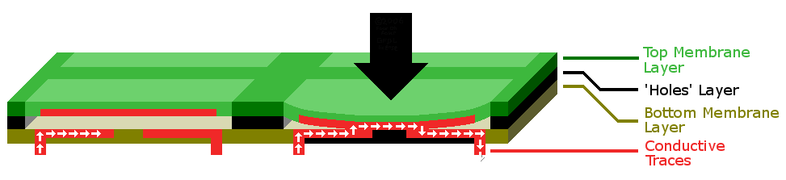
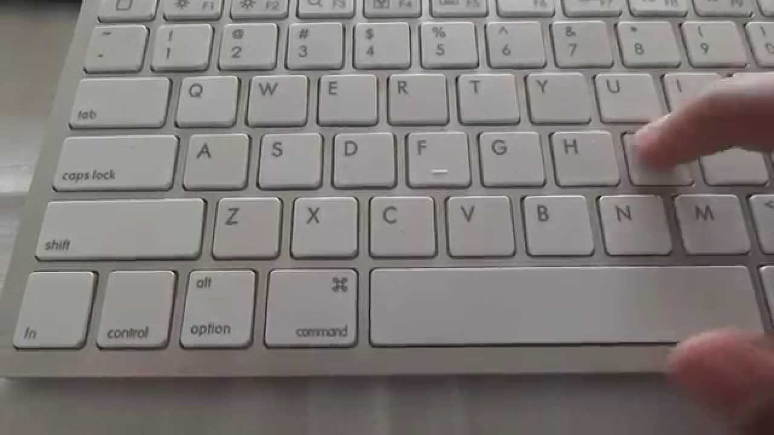
INPUT DEVICES
Mechanical Mouse
Optical Mouse
Mechanical Keyboard
Membrane Keyboard

Slide 6
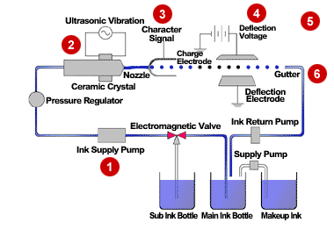
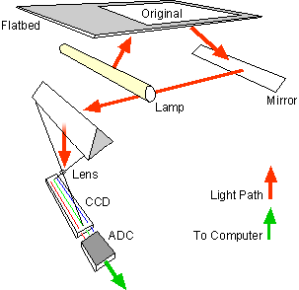
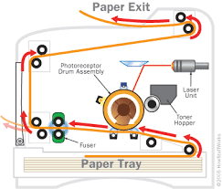
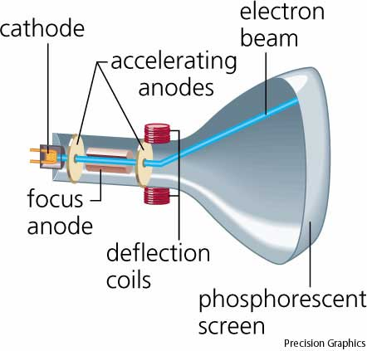
OUTPUT DEVICES
INPUT DEVICES
Laser printer
Flatbed scanner
Cathode ray tube monitor
Inkjet printer

Slide 7
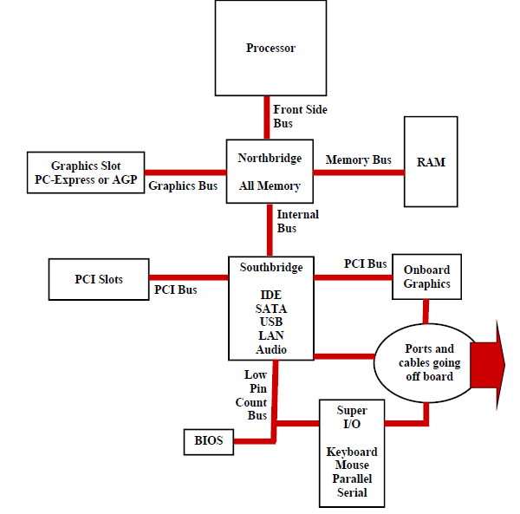
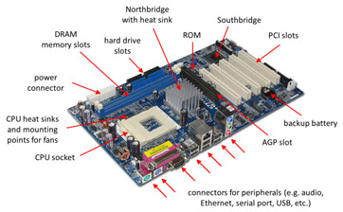
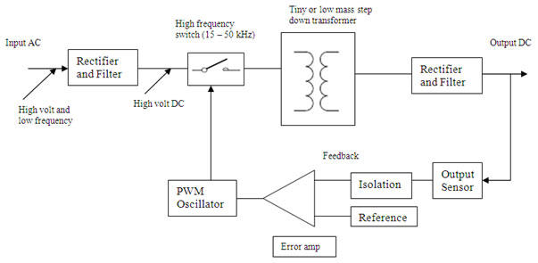
MOTHERBOARD
SMPS
Northbridge and Southbridge

Slide 8
MEMORY
Memory
Read Only Memory(ROM)
Random Access Memory(RAM)
Static Memory
Dynamic Memory
PROM
EPROM
EEPROM
STORAGE
Storage
Magnetic Storage
Optical Storage

Slide 9
WINDOWS
FUNDAMENTALS

Slide 10




KERNEL ARCHITECTURE
Logon Process Winlogon.exe
Win32 Application
Local Security Authority (LSA)
USER MODE
Win32 Subsystem
Security Accounts Manager (SAM)
EXECUTIVE SERVICES
I/O Manager
Local Procedure Call
Power Manager
Process and Thread Manager
Security Reference Manager
Configuration Manager (Registry)
Object Manager
Memory Manager
Plug and Play Manager
Kernel Transaction Manager
Cache Manager
Windows Manager
File System
Kernel
KERNEL MODE
Network Drivers
GDI
Hardware Abstraction Layer
Device Drivers
Graphics Drivers
HARDWARE

Slide 11
BOOTING PROCESS
SMPS
Power Good
Signal
Processor
Bios Initialization
OS Loader
Kernal Initialization
Session Initialization
Winlogon Initialization
Explorer Initialization
POST
Boot Priority
MBR
Boot Sector
Boot Manager
Boot Loader
(winload.exe)
Phase 0
Session 0
wininit.exe
services.exe
lsass.exe
logonui.exe
Loads HKCU registry
dwm.exe
userinit.exe
explorer.exe
Phase 1
Session 1
winlogon.exe
Ntoskernal.exe
Open known dlls(ex. hal.dll)
Initialize executive services
Loads System drivers
Loads registers

Slide 12
FILE SYSTEM
FAT
Boot Sector | FAT 1 | FAT 2 (Duplicate) | Other Folders and All
NTFS
NTFS Boot Sector | Master File Table | File System Data | Master File Table Copy

Slide 13
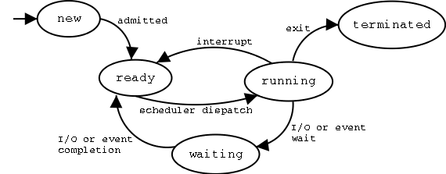
PROCESS STATE

Slide 14
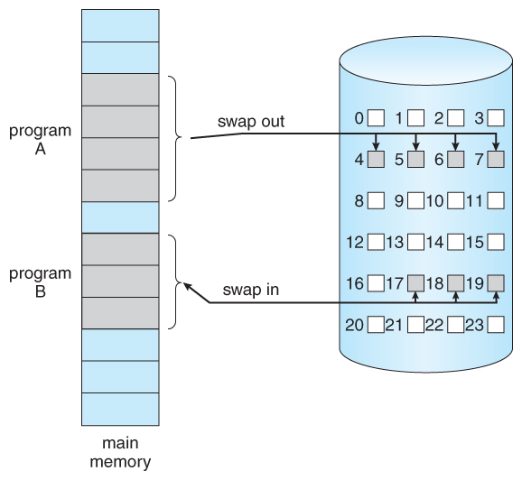
MEMORY MANAGEMENT
Types of memory:
Paging
Physical Memory
Virtual Memory
Segmentation
Fragmentation
Demand paging:
Bring a page into the memory when it is needed.
After a new page is loaded, the process starts execution from the beginning.

Slide 15
WINDOWS
ESSENTIALS

Slide 16
INTRODUCTION
DOMAIN :
Administrative logical boundary
Its not physically present but logical entity which perform multiple administrative activities.
DOMAIN CONTROLLER :
The server which host the domain.
ADDS :
Centralized repository for all domain information.
Performing authentication and authorization.

Slide 17
WDS :
windows deployment service
It is a server which gives the ability to the administrator to deploy windows OS remotely.
GROUP POLICY :
Set of administrative task which perform on domain user.
It’s provides centralized management and configuration of operating systems, applications, and users' settings in an Active Directory environment.

Slide 18
FSRM:
It is a role service in Windows Server that enables you to manage and classify data stored on file servers.
There are five main features in FSRM ->
Quota management
File classification
Storage reports
File screening management
File management

Slide 19
LINUX

Slide 20
LINUX SUBSYSTEMS
User applications
OS Services
Linux Kernel
Hardware Controllers

Slide 21
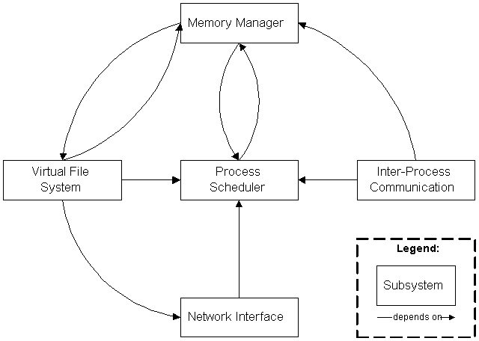
KERNEL AND ITS SUBSYSTEMS

Slide 22
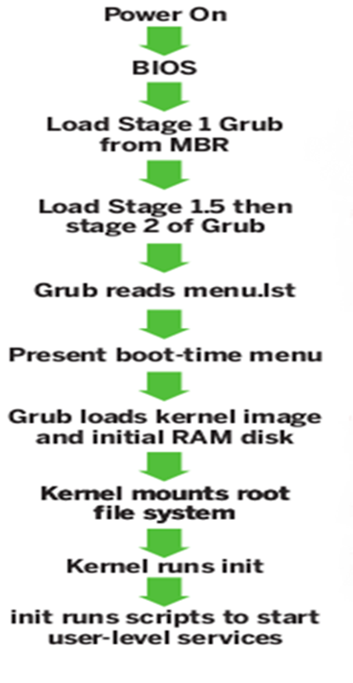
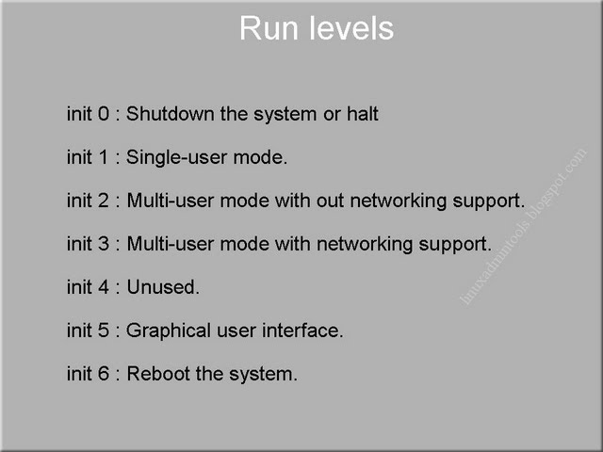
BOOTING PROCESS

Slide 23
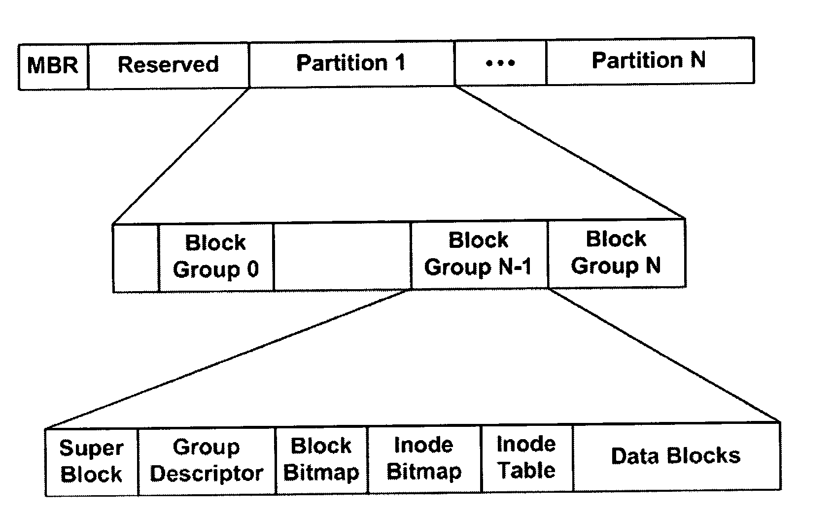
File System

Slide 24
PROCESS MANAGEMENT
Process Scheduling:
Non-preemptive:
1)FCFS (First Come First Serve)
2) SJF (Shortest Job First) Preemptive :
1)Round Robin 2)Priority Scheduling.
Types of Processes:
Init Process
Parent Process
Child Process
Zombie Process
Orphan Process
Daemon Process
Real-time Process

Slide 25
LINUX
ESSENTIALS

Slide 26
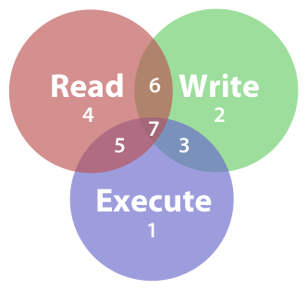
Group Administration
Linux group is a mechanism to organize a collection of users.
Like the user ID, each group is also associated with a unique ID called the GID (group ID).
There are two types of groups – a primary group and a supplementary group.
Permissions
File systems use permissions and attributes to regulate the level of interaction that system processes can have with files and directories.

Slide 27
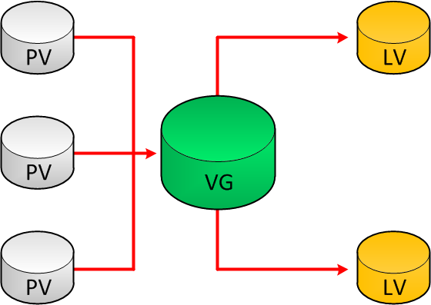
Partition
creating space, organizing space for new drives, re-organizing an old drives and copying or moving data to new disks.
TOP Command
It shows the top processes based on certain criteria's like cpu usage or memory usage.
The processes are listed out in a list with multiple columns for details like process name, pid , user, cpu usage, memory usage.

Slide 28
NETWORK
FUNDAMENTALS

Slide 29
INTRODUCTION OF NETWORKING
What is networking?
Advantages and disadvantages of networking
Types of network
Types of communication
WAN
MAN
LAN
Unicast
Multicast
Broadcast

Slide 30
INTRODUCTION OF NETWORKING
Network Terminologies
Internet
Intranet
Extranet
Fundamentals of network characteristics
Circuit switching
Packet switching

Slide 31
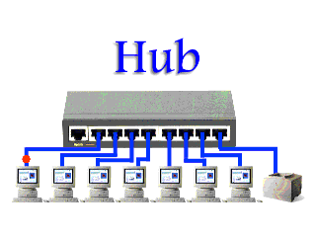
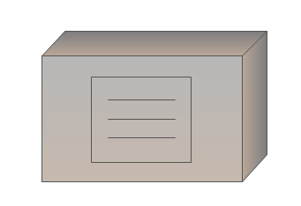
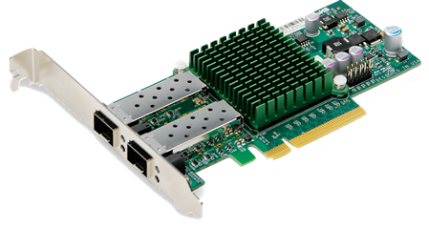
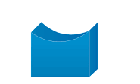
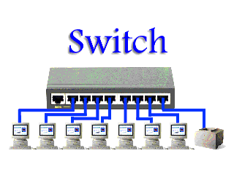
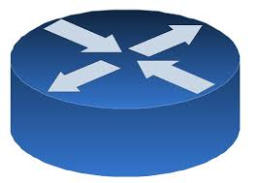
Network devices
NIC
HUB
Repeater
Bridge
Switch
Router

Slide 32
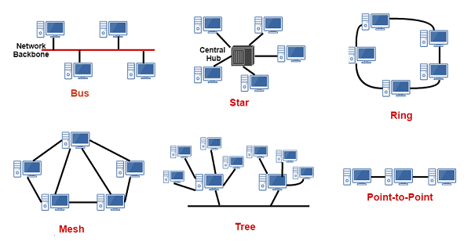
Network Topologies

Slide 33
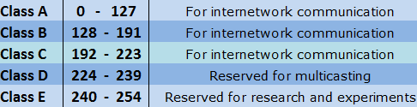
IP ADDRESSSING
IP(Internet Protocol) Address is logical address which is given to the devices connected to the network.
VERSIONS :
IPV4
IPV6
IPV4 CLASSES :
It is the strategy used to partition a single physical network into more than one smaller logical sub-networks.
SUBNETTING :
Notes:
A cor AZUL sempre tem que aparecer no slide. Seja nas formas ou no texto.
Uma imagem como essa nao funciona. Muito “Barbie” para uma consultoria. Eles gostam deste layout mas deveria estar separador de capitulos com o logo de “espadas” maior. Para toda insercao de imagem o fundo deve ser cinza claro.

Slide 34
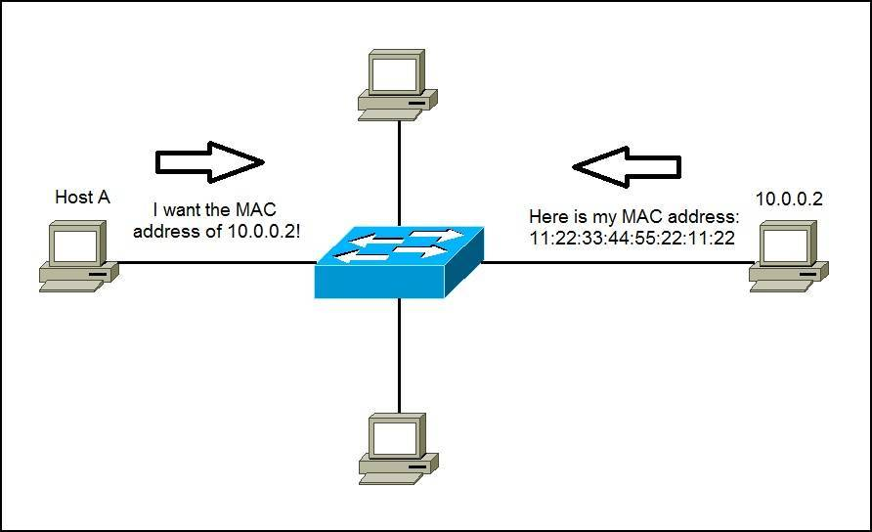
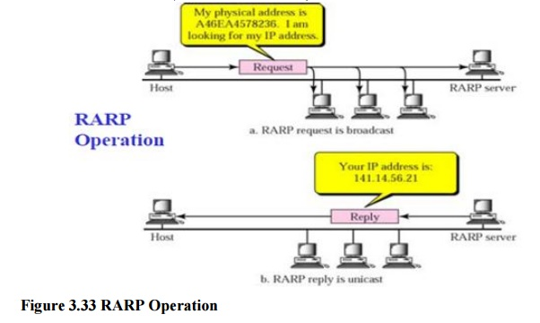
Network Concepts
ARP
RARP
Notes:
A cor AZUL sempre tem que aparecer no slide. Seja nas formas ou no texto.
Uma imagem como essa nao funciona. Muito “Barbie” para uma consultoria. Eles gostam deste layout mas deveria estar separador de capitulos com o logo de “espadas” maior. Para toda insercao de imagem o fundo deve ser cinza claro.

Slide 35
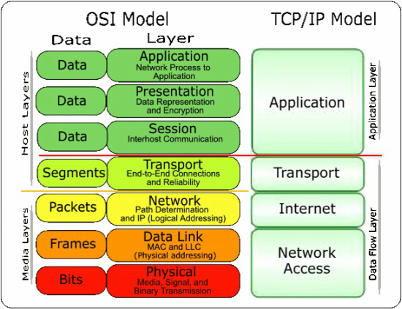
OSI and TCP/IP Model

Slide 36
NETWORK
ESSENTIALS

Slide 37
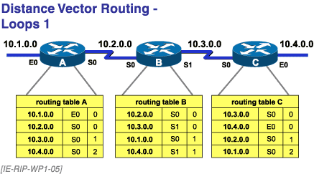
ROUTING PROTOCOLS
RIP

Slide 38
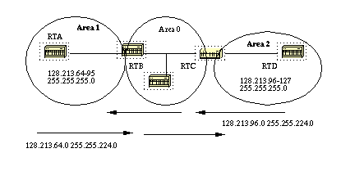
OSPF

Slide 39

EIGRP
I KNOW MY NEIGHBOURS
ME TOO
ME TOO
1
2
3
4

Slide 40
Comparison between the protocols
Routing protocol | Metric | AD value | Syntax
RIP | Hop count | 120 | #router rip #version 2 #network <source n/w ID> #no auto summary
OSPF | Cost | 110 | #router ospf<processid> #network <source n/w ID><wildcard mask> area<area ID>
EIGRP | Bandwidth and delay | Internal = 90 External = 170 | #router eigrp<AS no.> #network <source n/w ID> #no auto summary

Slide 41
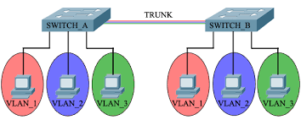
SWITCHING
VLAN

Slide 42
NETWORK
SERVICES

Slide 43
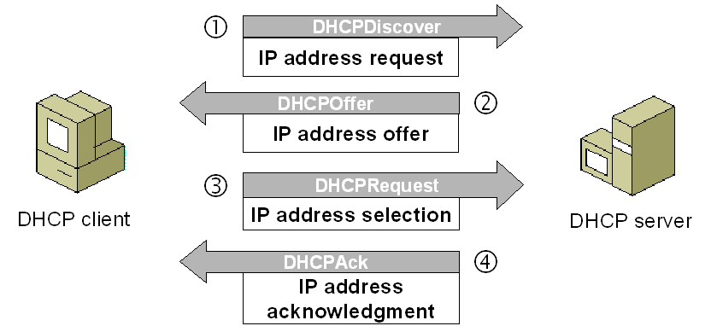
DHCP
Dynamic Host Configuration Protocol (DHCP)
client/server protocol
Dynamic IP address allocation
DORA Process :

Slide 44
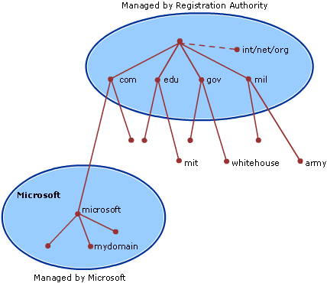
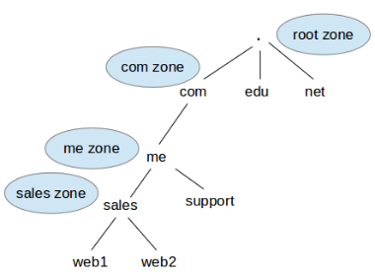
DNS
Domain Name Servers maintain a directory of domain names and translate them to Internet Protocol.
DNS Hierarchy
DNS Zone

Slide 45
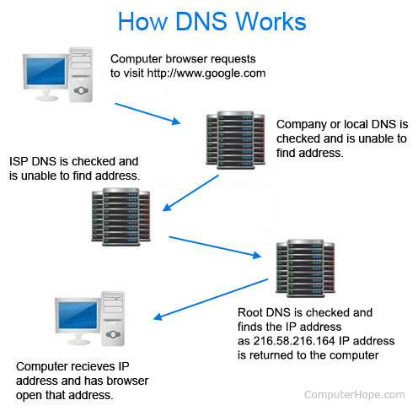
DNS

Slide 46
Directory service
Directory Service:
Directory Service identifies all resources on a network
Makes them accessible to users and applications.
Active Directory:
For Windows domain networks and contains information of all active users.
Domain Controller:
Server running Active Directory Domain Services (AD DS).
Authenticates and authorizes all users and computers in a Windows domain type network.
Notes:
A cor AZUL sempre tem que aparecer no slide. Seja nas formas ou no texto.
Uma imagem como essa nao funciona. Muito “Barbie” para uma consultoria. Eles gostam deste layout mas deveria estar separador de capitulos com o logo de “espadas” maior. Para toda insercao de imagem o fundo deve ser cinza claro.

Slide 47
Directory service
X.500:
X.500 is a computer networking standard covering electronic directory services.
Its purpose is to centralize an organization's contacts and resources.
Lightweight Directory Access Protocol:
For accessing and maintaining directory services over an Internet Protocol.
LDAP directory is organized in a tree hierarchy with Objects, containers.

Slide 48
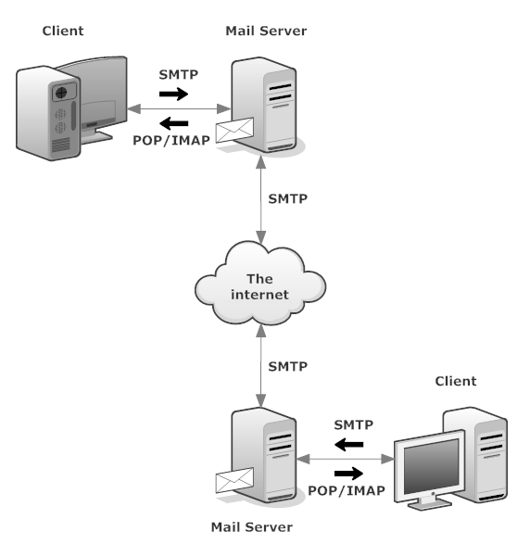
Mail service
Working process:
Electronic mail is sent via the internet to a recipient.
Protocols used in mail services : SMTP, POP3 and IMAP4
Mail User Agent (MUA)
Mail Transfer Agent (MTA)
Mail Delivery Agent (MDA)
Mail Exchanger Record (MX)

Slide 49
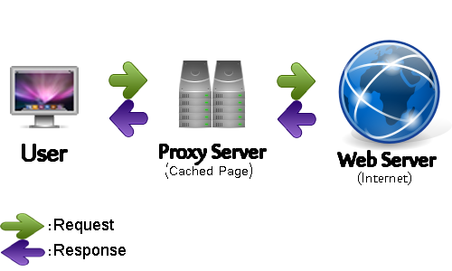
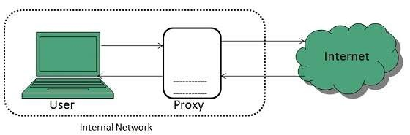
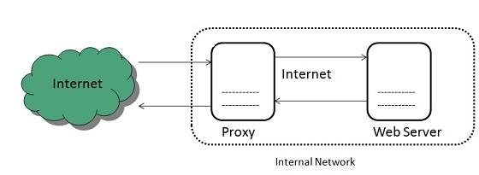
Proxy service
A proxy service is an intermediary role played by dedicated computer system between an endpoint device and a client which is requesting the service.
Forward proxy
Reverse proxy

Slide 50
DATABASE
MANAGEMENT
SYSTEM

Slide 51

DATABASE FUNDAMENTALS
Database:
Database Models:
Flat file model
Hierarchical Model
Network Model
Object Model
Relational Model

Slide 52
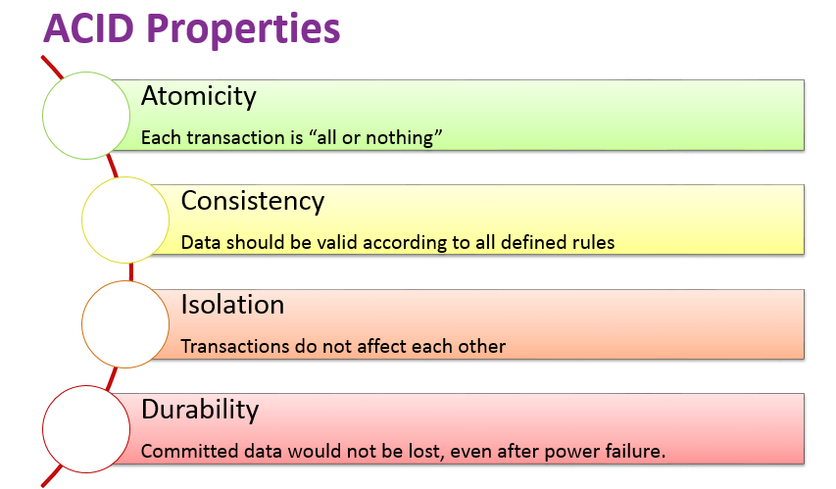
ACID PROPERTIES OF DATABASE

Slide 53
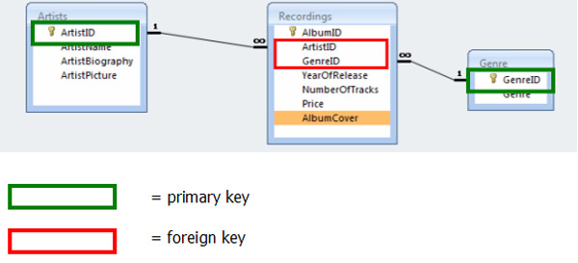
Terminologies
Entity
Attribute
Domain
Tuple
Degree
Cardinality
Relational database
Constraints
Not null
Default
Unique
Primary key
Foreign key
Check

Slide 54
Normalization
Used to define “well-formed’ tables.
1NF : As per the rule of first normal form, an attribute (column) of a table cannot hold multiple values. It should hold only atomic values.
2NF : Table is in 1NF and No non-prime attribute is dependent on the proper subset of any candidate key of table.
3NF : For 3NF, Table must be in 2NF and Transitive functional dependency of non-prime attribute on any super key should be removed.
BCNF : It is an advance version of 3NF that’s why it is also referred as 3.5NF. BCNF is stricter than 3NF. A table complies with BCNF if it is in 3NF and for every functional dependency X->Y, X should be the super key of the table.

Slide 55
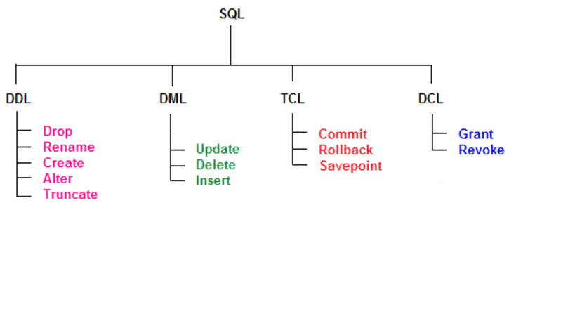
SQL (STRUCTURED QUERY LANGUAGE)
SQL (Structured Query Language) is a computer language aimed to store, manipulate, and query data stored in relational databases.

Slide 56
APPLICATION

Slide 57
Introduction
Components of Application
Presentation logic
Business logic
Data persistence logic
Presentation Logic
Business
Logic
Data Persistence Logic

Slide 58
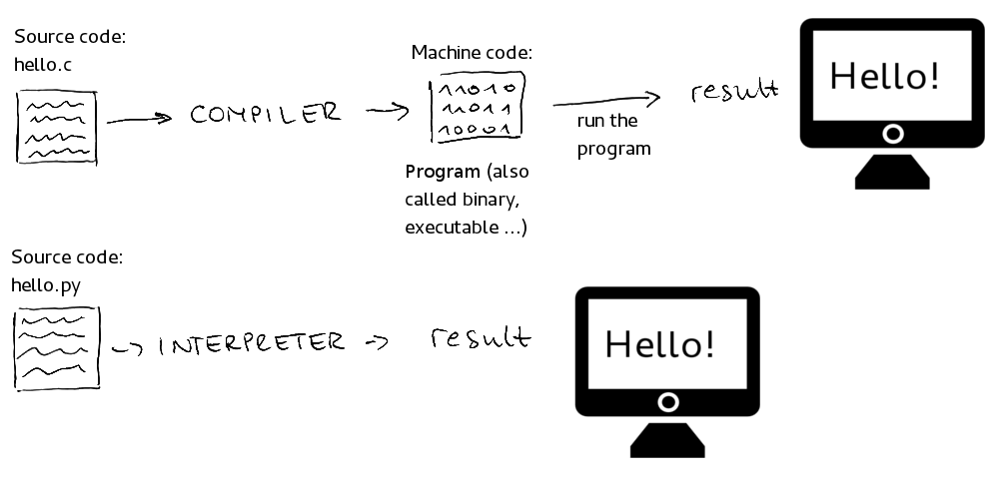
COMPILED VS INTERPRETED

Slide 59
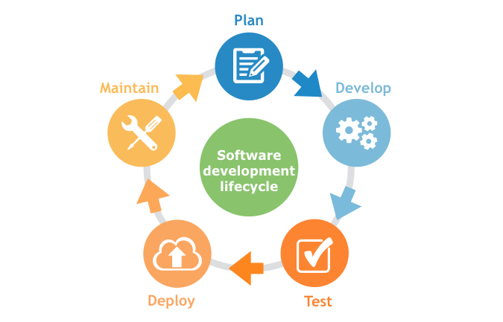
Application
Life cycle of application:
Requirement gathering
Design
Build and test
Deploy
Maintenance
Application Programming Interface:
An application program interface (API) is code that allows two software programs to communicate with each other.

Slide 60
Application architecture types:
Thick client
Thin client
Rich internet
Tier:
2 tier application
3 tier application
Presentation/ Business
Database
Two tier architecture
Presentation
Business
database
Three tier architecture

Slide 61
STORAGE

Slide 62
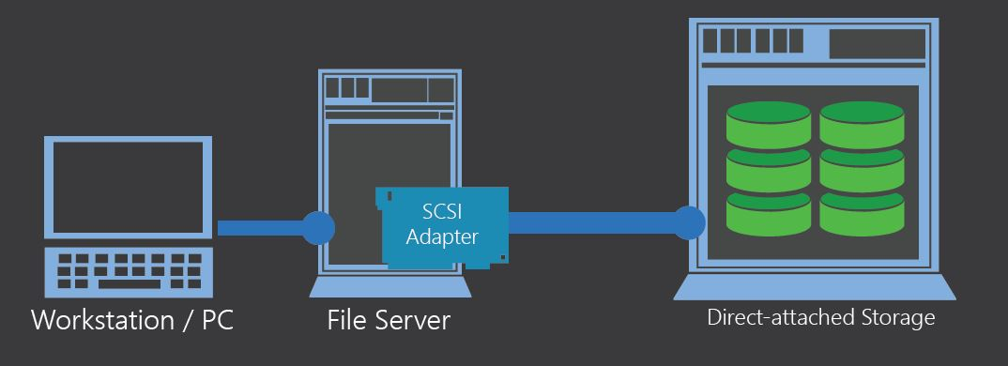
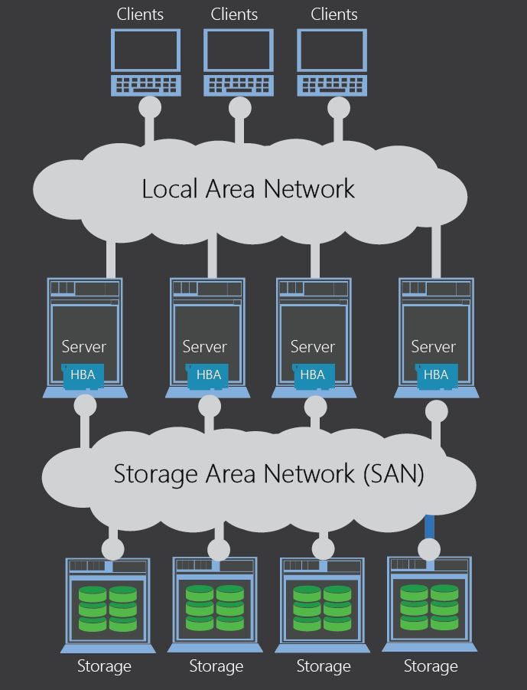

Storage Types

Slide 63



RAID
(Redundant array of independent disk)

Slide 64


RAID (CONTINUED..)
RAID 5
RAID 6

Slide 65

Virtualization
Virtualization is the process of creating a software-based representation of something
rather than a physical one.

Slide 66

Hypervisor

Slide 67

vSphere environment

Slide 69


Slide 70

DHCP HEADER FORMAT

